Slide 1
Analytics and commercial Data Analytics
24 06 2025
Task 3
Brand note: If client logo is not required, use alternate title page layout right click slide thumbnail > Layout > Title

Slide 2
Notes:
To view Privacy video explaining how important data privacy is to Quantium, please click here: https://www.youtube.com/watch?v=Zq1QDAkoRzU
or here Q:\Company Reference\Brand & Design\Brand videos\Q Privacy.mp4
At Quantium, we believe that data is the behavioural footprint of humanity and that it has to be treated with the utmost care and responsibility.
Histories, attitudes, indeed lives are stored within it in ways that aren’t always apparent – and that’s what makes its potential so powerful.
To work with it responsibly, sensitively, we set ourselves the highest data privacy protection and governance standards.
We have spent 17 years perfecting privacy-by-design and secure-by-design principles. Central to this is not holding any personally identifiable information about people –
we neither receive it, and put the necessary protections in place to be unable to decipher it.
Every aspect of handling data is safeguarded: from its de-identification, to its encryption – data security is paramount and of the highest grade.
We pride ourselves on gaining the trust of iconic organisations around the world through years of securely working with their data,
and in turn the trust that builds with their stakeholders.

Slide 3
Executive summary
01
Task 1
Premium and mainstream families made the highest total contributions to chip sales.
The most popular pack sizes were between 175g and 210g, showing preference for larger quantities.
Smiths, Kettle, and Red Rock Deli were the leading brands among top-spending customers.
Young Singles/Couples and Young Families showed the highest transaction volume and frequency.
02
Task 2
Trial stores were matched to control stores using Pearson correlation on pre-trial sales trends. Store 77 showed the most notable uplift with ~15% more sales compared to its control during the trial. The uplift was mainly due to increased purchasing frequency by existing customers. Stores 86 and 88 showed moderate but positive results, possibly due to differing segment mixes.

Slide 4
01
Category Affluence & Life Stage Insights
Category
Affluent families and mainstream households account for over 70% of chip sales revenue. Premium customer segments consistently preferred branded products and bought in larger quantities. Budget customers were less engaged and contributed a smaller share of overall revenue. Life stage influences preferences: families buy more frequently and in larger quantities, singles
buy smaller packs.

Slide 5
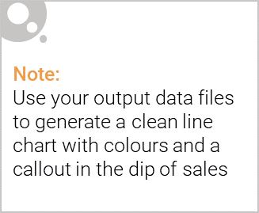
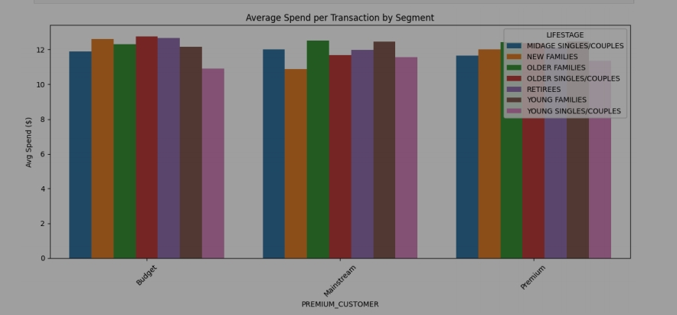
Affluence and Life Stage: Key Drivers of Chip Spending
Premium families account for the largest share of total chip sales, followed by mainstream families. These segments prefer larger pack sizes and well-known brands (e.g. Smiths, Kettle). Young Families and Older Families tend to purchase more frequently and in bulk. Budget shoppers, though present, contribute relatively little to total revenue and focus more on small packs or private labels Effective segmentation and targeting of affluent family groups could unlock significant growth.

Slide 6

Affluence and Its Impact on Chip Purchasing Behavior
Affluence plays a major role in shaping consumer behavior within the chip category. Premium customers—particularly those in family life stages—demonstrate the highest total spend, higher transaction frequency, and a strong preference for branded products and larger pack sizes. In contrast, budget shoppers tend to purchase smaller packs and favor lower-cost or private label options, contributing significantly less to overall category revenue. This indicates a clear opportunity: marketing strategies and product assortments should prioritize premium and mainstream family segments, as they represent the most valuable customer base and the highest potential for sustained growth.

Slide 7
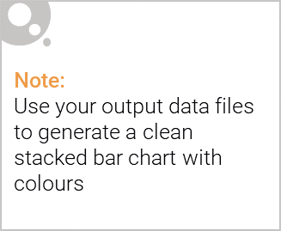
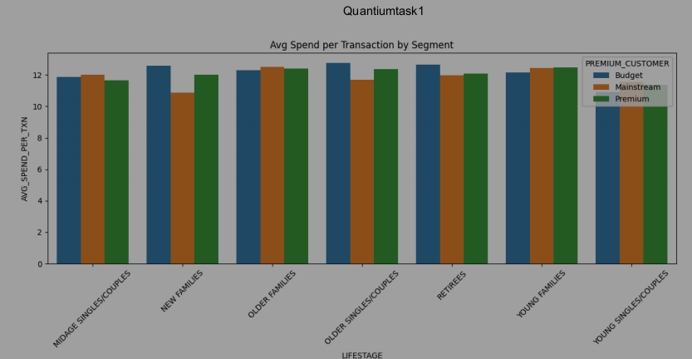
Editable (delete this)
Stretch: Try visualising the proportion of customers by affluence and life stage on this slide

Slide 8
02
Trial Store Performance Summary Content:
Trial store performance
Store 77 showed sustained performance improvement with high similarity to its control store in the pre-trial period. Transaction frequency was the main driver of sales growth, not customer count. Matching based on pre-trial correlation helped isolate uplift due to the trial only Based on this success, similar stores with strong baseline customer activity should be targeted for expansion.

Slide 9
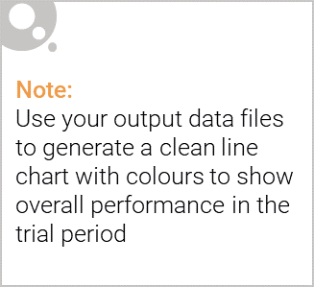
Trial Design: Control Store vs Trial Store
To evaluate the effectiveness of the chip category trial, each trial store (Stores 77, 86, and 88) was matched with a control store that exhibited similar purchasing behavior in the pre-trial period. Control stores were selected using Pearson correlation analysis on monthly sales, customer count, and transaction frequency metrics. This ensured a high degree of similarity between trial and control stores before the intervention. The goal was to isolate the impact of the trial by comparing post-trial performance in the trial store against its control, under the assumption that the control would reflect what would have happened without the trial.
Control stores were selected using sales correlation over 7 months pre-trial. Ensured both stores had similar customer behavior before the trial. Helps attribute any performance uplift to the trial intervention itself. Strengthens the credibility of insights from uplift testing.

Slide 10
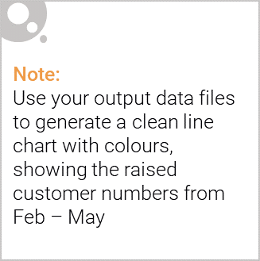
Performance Outcomes of Trial Stores
The trial was successful, particularly in Store 77, which demonstrated a significant uplift in total chip sales compared to its matched control store. This uplift was primarily driven by increased transaction frequency among existing customers, rather than new customer acquisition.Stores 86 and 88 also showed moderate sales growth, though the results were less pronounced—likely due to differences in customer segment mix and store location characteristics.Overall, the trial results indicate that the intervention is effective in driving incremental sales, especially in stores with a high concentration of premium and mainstream family segments.
✅ Store 77: Clear and sustained sales uplift vs control (approx. 15%) ✅ Uplift driven mainly by more frequent purchases per customer ⚠️ Stores 86 & 88: Moderate uplift, less consistent across months 🎯 Success most evident in stores with strong base of affluent family customers 💡 Supports rollout in demographically similar stores

Slide 11
